Slide 1
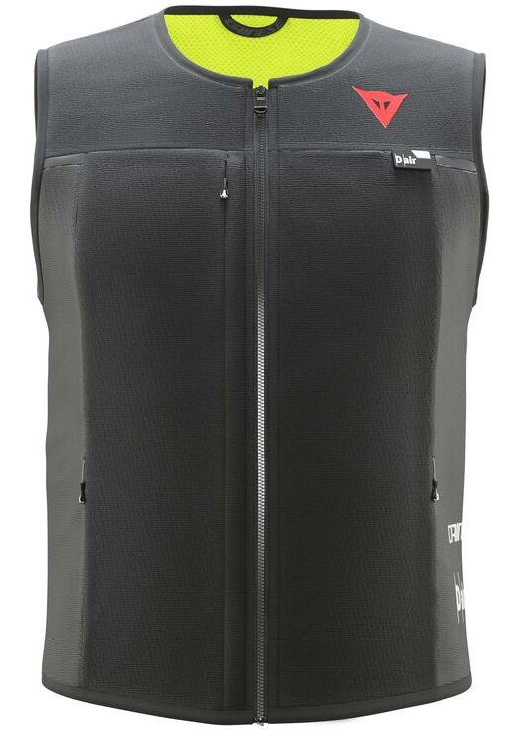
Smart Wearable AI IOT for Appliance Control
Created by :-
Anindya Trivedi (191500116)
Biprajit Debnath (191500221)
Devansh Jain (191500254)
Akarsh Agarwal (191500069)
Akash Nigam (191500074)
-Submitted to Dr Hitendra Garg
(Associate Professor CEA)

Slide 2
Introduction
The present invention relates to field of electronics and communication, more particularly a low cost wearable health monitoring device which can be used for keep an eye on the vital information of aged or disabled person and simultaneously communicate the doctor in case of an emergency situation occurs.
The present invention provides a Low-Cost Wearable Health Monitoring Device comprising plurality of sensors to measure the vital information of a aged and disabled person; a module consisting pre-programmed controller which store the normal vital parameter to be, during disability or ageing and based on comparison generating an alert signal which is transmitted through a transmitter to ambulance, doctor and family member; a communication device adapted for continuous establishment of network with the data storing means where the vital information gets stored; and output means from where the family member and doctor can access the information. The system has an advantage of creating proper data base of disable person and is cost-efficient and reliable.

Slide 3
Problem Statement
There are many problems faced by old people in the later stages of life regarding health whether they are serious or not.
The main focus of these project is to keep a check/surveillance on the health of old people 24*7 hours as it is hard for them to have health check ups in a regular interval and also for others to always keep a check on the health conditions which may lead to major health problems in the future and proof injurious to their health and life.
This will lead to a decrease in the death rate in the aged person.
This project will solve all these major problems that are faced by aged person and this will be very beneficial for both the person and the doctor as person doesn’t have to go for routine checkup but whenever there is requirement our project will notify both the person and the doctor.
As this device is going to be reusable i.e. this device can be used multiple times. Hence, this wearable health monitoring device for pregnant women can be easily affordable by anyone.

Slide 4
Solution
IOT device is fixed on the safety jacket .This smart jacket is fixed with 9 useful sensors for monitoring the health of the aged person.
These sensors are connected across network through Wi-Fi under IEEE standard 802.11 b/g/n makes more relevant and valuable ever than before.
By turning sensor information into actions, real time data of person health can be monitored and controlled remotely from anywhere.
The information can be monitored through an ISO android app and personal computers remotely.

Slide 5
Needs
Goals
By trapping real time data and allow adjustments to be made before anything can go wrong.
Reduce the risk associated with every step of the mining process.
Monitor each and every miners in mining environment by providing Smart Safety Jacket for each miners.
To alert miners in case of hazards.
Work in a safety, comfort and efficient environment.
Wearing smart safety jacket is necessary
The person should be remotely monitored and traced continuously for safety
Free from Health Hazards
Best Communication technology
Only those who are wearing the smart safety jacket should be allowed at the site.

Slide 6
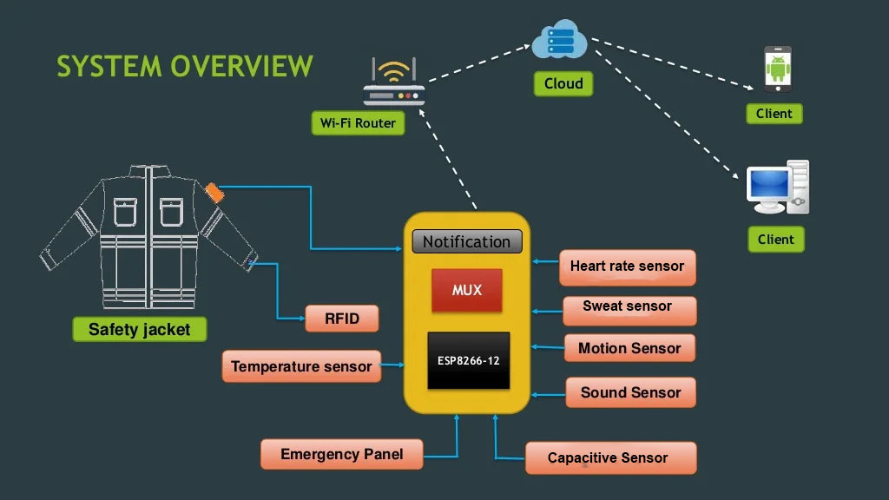

Slide 7
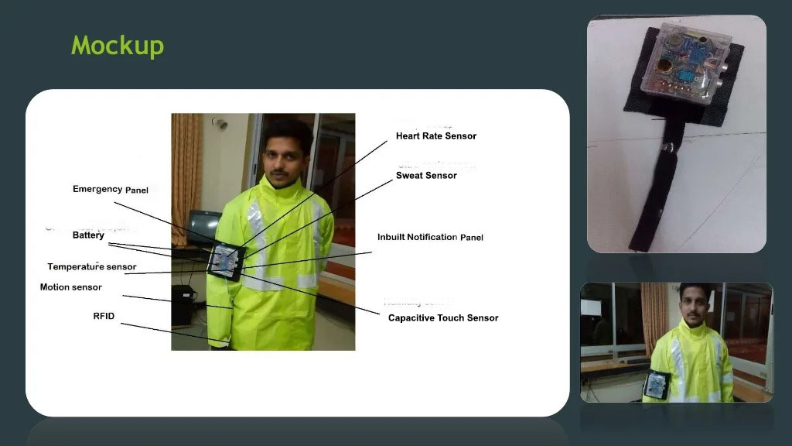

Slide 8
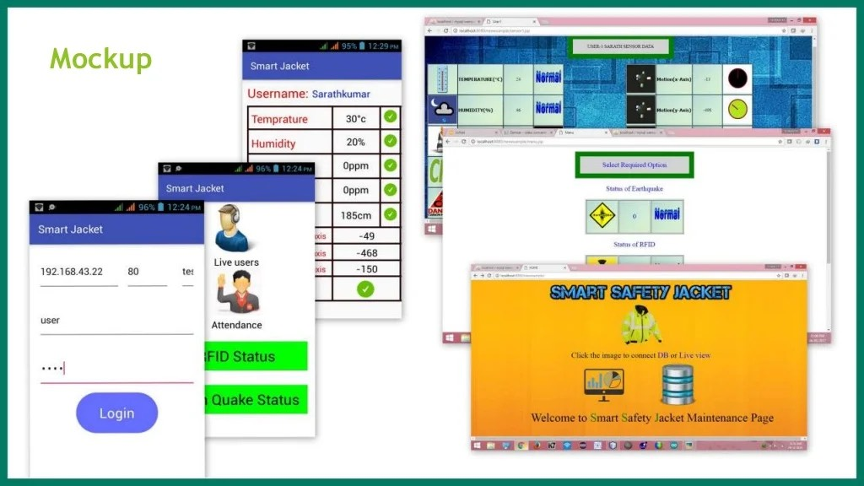

Slide 9
Sensor Name | Sensor Images | Specifications/Cost
Heart Rate Sensor |  | Heart Rate Sensor Cost: - Rs 230.00
GSR Sensor |  | Sweat Sensor Cost: - Rs 999.00
MPU-6050 |  | MPU6050 Cost: - Rs 115.00
Analog Tempurature Sensor |  | Analog Temperature Sensor Cost: - Rs 39.00
RFID Reader/Writer |  | RFID Reader/Writer Cost: - Rs 132.00
Capacitive Touch Sensor |  | Capacitive Touch Sensor Cost: - Rs 379.00
Node MCU ESP-8266 |  | NodeMCU ESP8266 Cost: - Rs 349.00

Slide 10
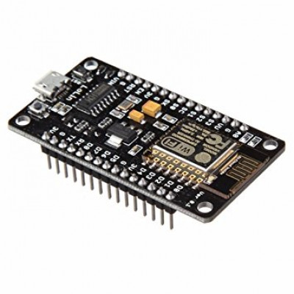
Microcontroller ESP8266-12
ESP-12E Wi-Fi module is developed by Ai-thinker Team. core
processor ESP8266 in smaller sizes of the module
encapsulates Ten-silica L106 integrates industry-leading ultra
low power 32-bit MCU
Features:
Supports IEEE 802.11 b/g/n
Integrated low power 32-bit MCU
Integrated 10-bit ADC
Integrated TCP/IP protocol stack
Wi-Fi 2.4 GHz, support WPA/WPA2
SDIO 2.0, (H) SPI, UART, I2C, I2S, IRDA, PWM, GPIO
Operating temperature range -40C - 125C

Slide 11
Alerting System
Alerting people in case of emergency can be a difficult process .There must be a proper system for communicating the problem faced by the people to their family members.
So the best way of alerting the people of household by flashing the LED on smart safety jacket . Flashing the light constantly and simultaneously can show who is experiencing the problem.
Emergency Panel
In Case of any emergency if the people press the emergency button on Smart Safety Jacket the logic changes from 0 to 1 and sends notification to control room that the particular people is in danger.

Slide 12
Capacitive Touch Sensor:-
Features:
Wide voltage range from 3.3V to 5V
Standard assembling structure (two 3mm holes with multiple of 5cm as interval)
Easily recognitive interfaces of sensors (“A” for analog and “D” for digital)
Icons to simply illustrate sensor function
High quality connector
Analog Temperature Sensor : -
Features:
Operating Voltage: 5v.
Temperature measurement range : -55°C to 125°C.
Measurement Accuracy : ±0.5°C.

Slide 13
MPU6050 :-
Features:-
Uses the popular MPU6050 IC
MPU6050 contains a 3 axis Accelerometer and Gyroscope in a single package and simplifies design and usage. It also reduces cross axis alignment issues unlike other sensors with separate accelerometer and gyroscope ICs
Digital I2C interface to read the output of the sensor
Input Voltage: 2.3 - 3.4V
Selectable Solder Jumpers on CLK, FSYNC and AD0
Tri-Axis angular rate sensor (gyro) with a sensitivity up to 131 LSBs/dps and a full-scale range of ±250, ±500, ±1000, and ±2000dps
Sweat Sensor:-
Features:
Detects conductance of the skin
Finger Straps for electrodes

Slide 14
RFID Reader/Writer :-
Features :
Highly integrated analog circuitry to demodulate and decode responses.
Supports ISO/IEC 14443 A/MIFARE.
Typical operating distance in reading/Write mode up to 50 mm.
Supports ISO/IEC 14443 A higher transfer speed communication up to 848 kBd.
SPI up to 10 Mbit/s.
FIFO buffer handles 64 bytes send and receive.
Flexible interrupt modes.
Power-down by software mode.
Programmable Timer.
2.5 V to 3.3 V power supply.
Heart Rate Sensor :- Features:
Compatible With Arduino
Digital Output Sensor
Works on 5VDC

Slide 15

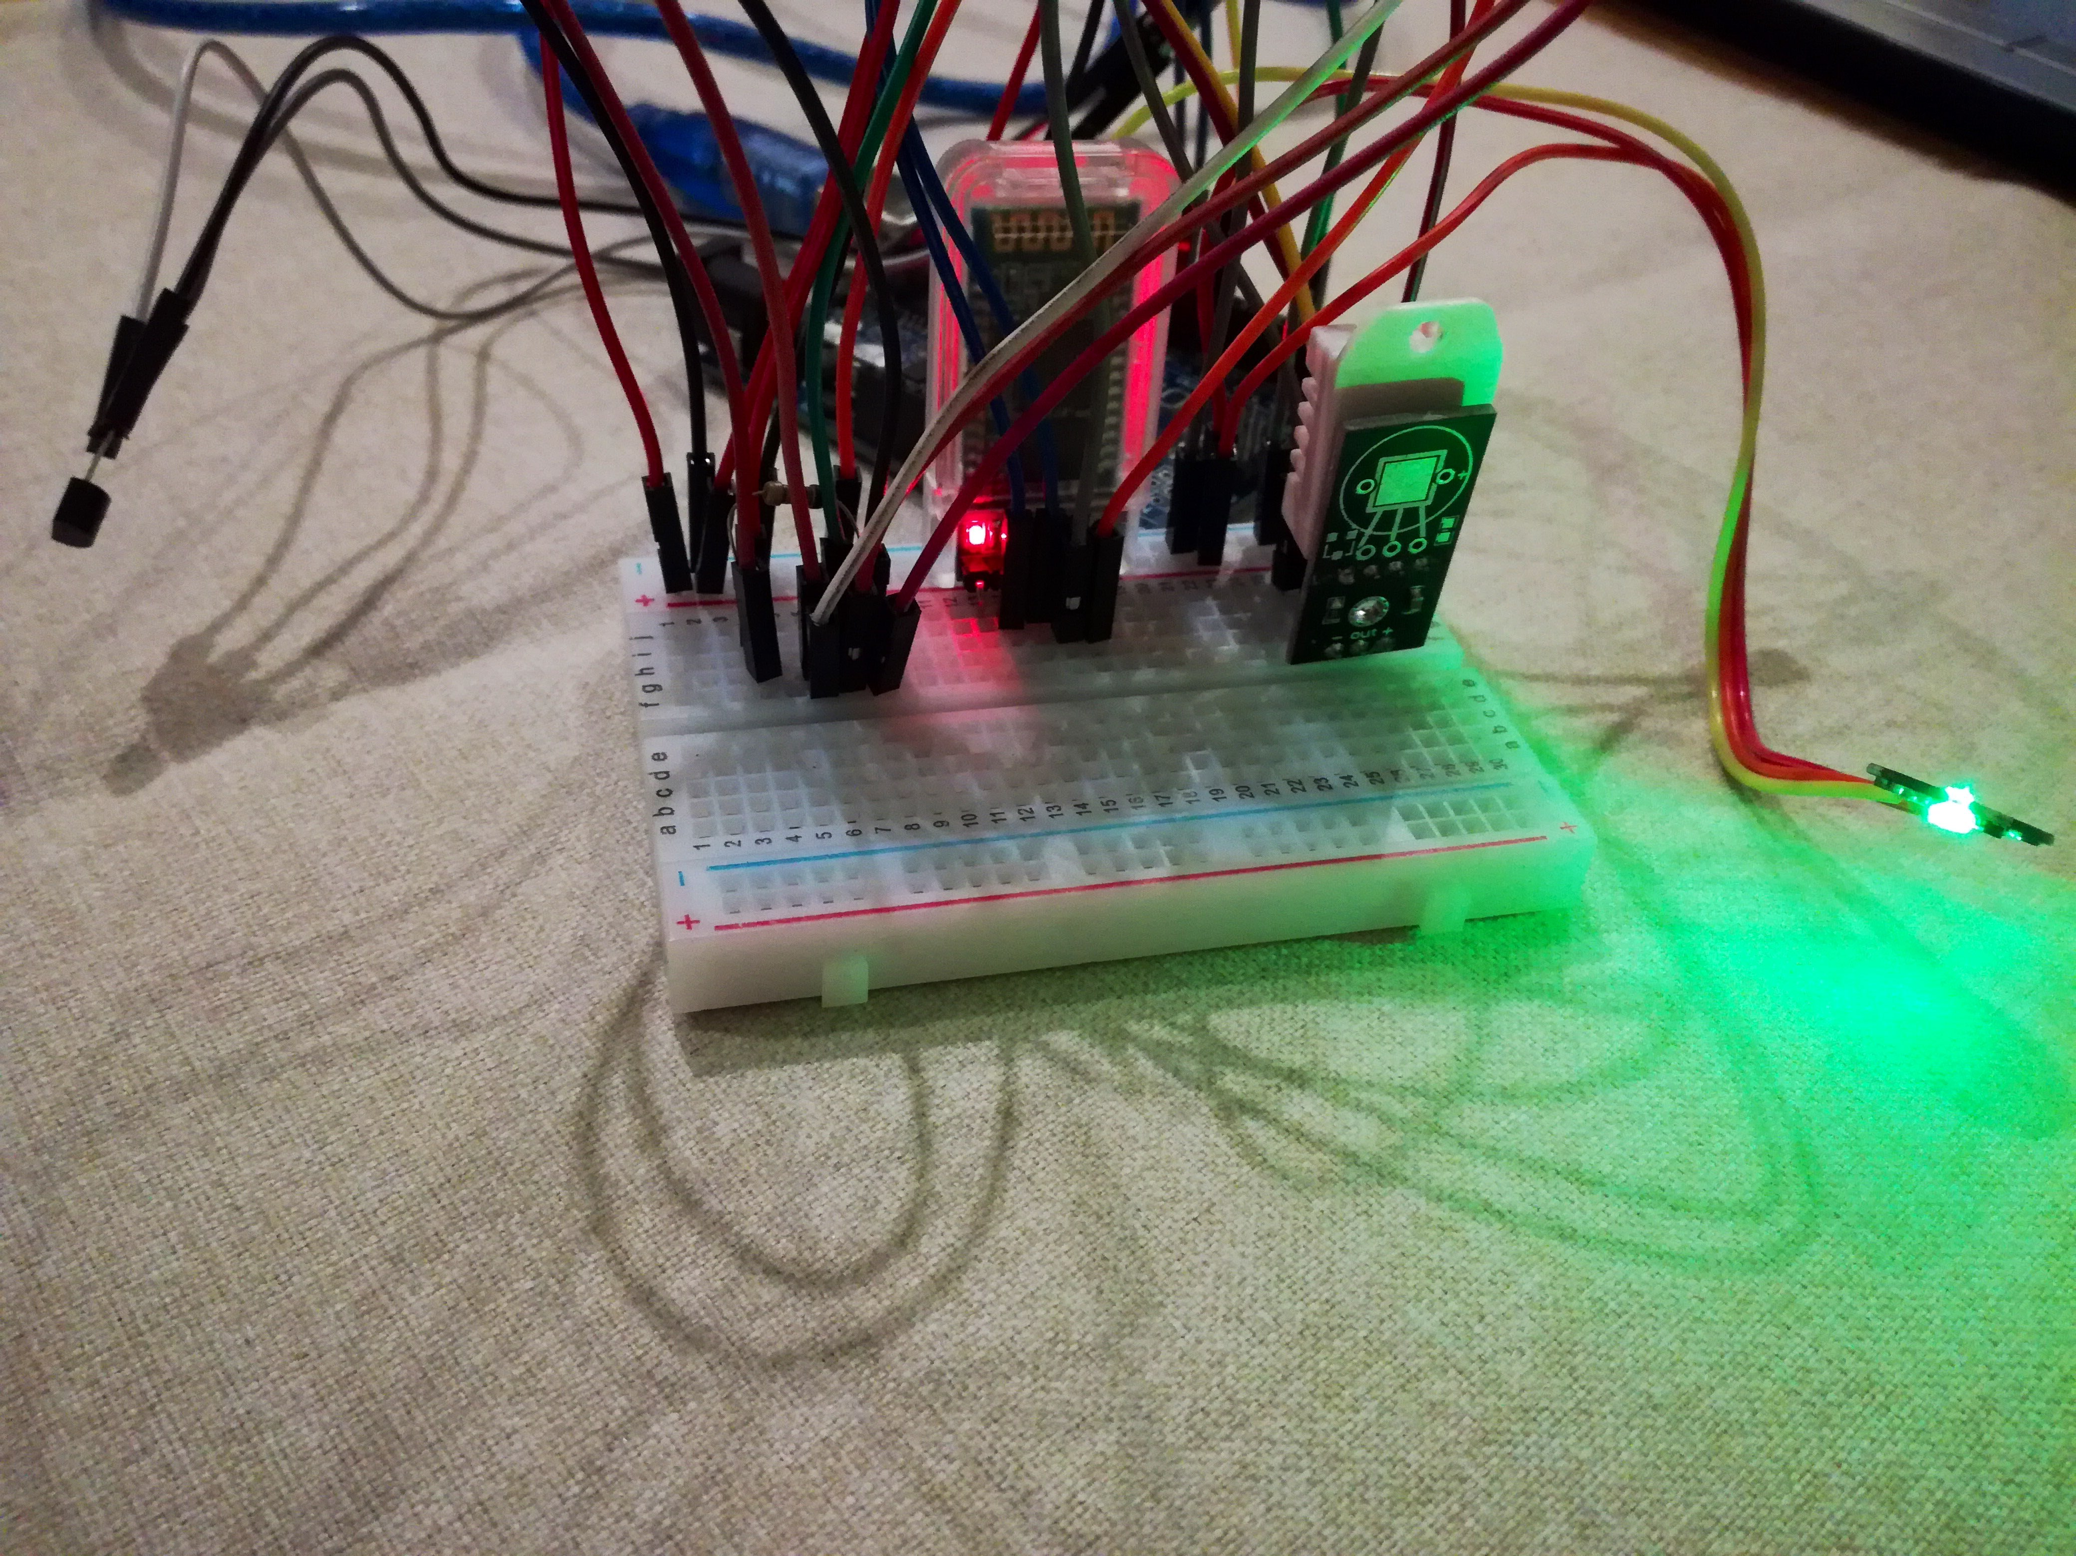
Proposed Code and Circuit Diagram :-
The IOT device is fixed on the safety jacket .This smart jacket is fixed with 9 useful sensors for monitoring the health of the aged person. These sensors are connected across the network through Wi-Fi under IEEE standard 802.11 b/g/n makes them more relevant and valuable than ever before. By turning sensor information into actions, real time data of personal health can be monitored and controlled remotely from anywhere. The information can be monitored through an ISO android app and personal computers remotely.
The code of integrating the sensors are updated in the GitHub repository link of our major project and can be accessed from there. The link is provided below :-
SmartWearable

Slide 16
Reference - 1 :-
A Smart Helmet for Air Quality and Hazardous Event Detection for the
Mining Industry
C. J. Behr, A. Kumar, G. P. Hancke
2016 IEEE International Conference on Industrial Technology (ICIT)
Year: 2016
Pages: 2026 - 2031, DOl: 10.1109/ICIT.2016.7475079
Reference - 2 :-
Zig-Bee Based Intelligent Helmet For Coal Miners
Arun Katara, Anand Dandale, Abhilesh Chore, Anura Bhandarwar
2015 Fifth International Conference on Communication Systems and Network Technologies
Year: 2015
Pages: 314 - 317, DOI:10.1109/CSNT.2015.142
IEEE Conference Publications

Slide 17
Conclusion
The project has proposed the idea of smart wearable that can support to keep a health track for a lot of aged people at a very cheap and affordable price. The smart wearable contains a connection between wearless communication, several sensors, monitoring and tracking. In this project a smart and efficient approach for Smart Wearable AI IOT for Appliance Control was proposed and implemented.
—Thank You

